Slide 1
Best location to open a coffee shop in Boston area

Slide 2
The mail goal will be focusing on analyzing universities and coffee shops data in Boston area to be able to find the least busy coffee shop in terms of student numbers per Coffee Shop.

Slide 3
To make the choice of best location, the following information is needed
List of the universities in Boston area
List of the coffee shop in Boston area
The number of the student for each university

Slide 4
The dataset will be composed from the following two main sources
Wikipedia, which provide the Enrollments of each university in State of Massachusetts. https://en.wikipedia.org/wiki/List_of_colleges_and_universities_in_Massachusetts
FourSquare API which provides the surrounding venues of a given coordinates.

Slide 5
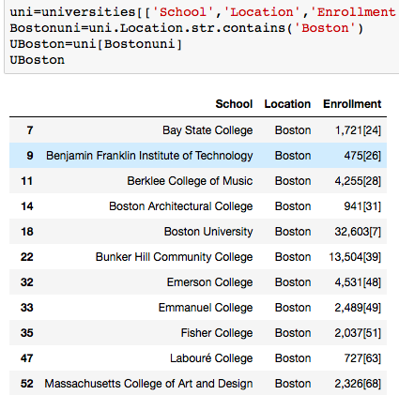
Scrap the Wikipedia webpage for a list of Massachusetts universities and enrollment numbers for each university

Slide 6
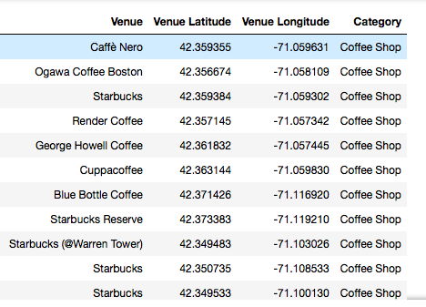
Foursquare tool will be necessary to explore the coffee shops around the each University. By using API queries, it is possible to aggregate coffee shop location data.

Slide 7
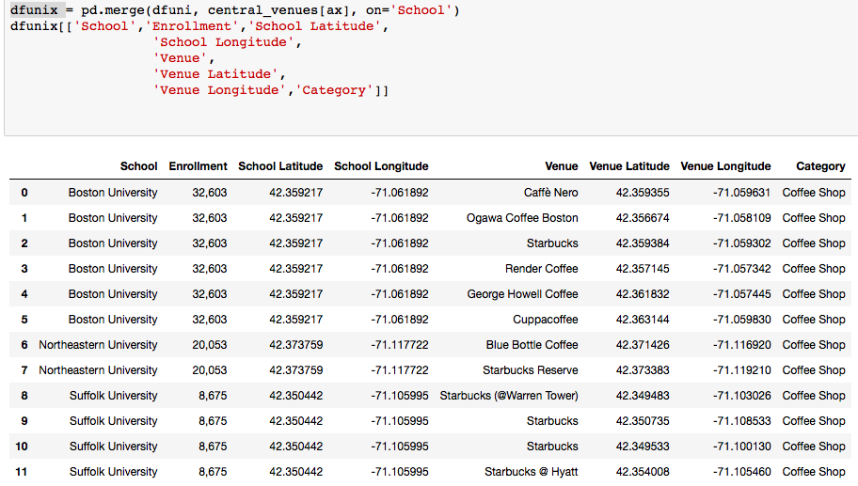
After retrieving the coffee shop location data and combining them with University data, it will be possible to manipulate the data accordingly

Slide 8
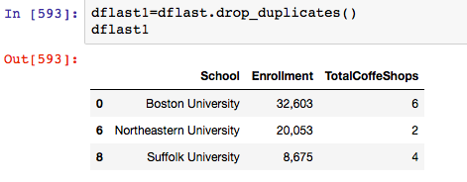
After manipulating all the data, It will be seen that Northeastern University area is the best location since it has the most student population per coffee shop

